Slide 1
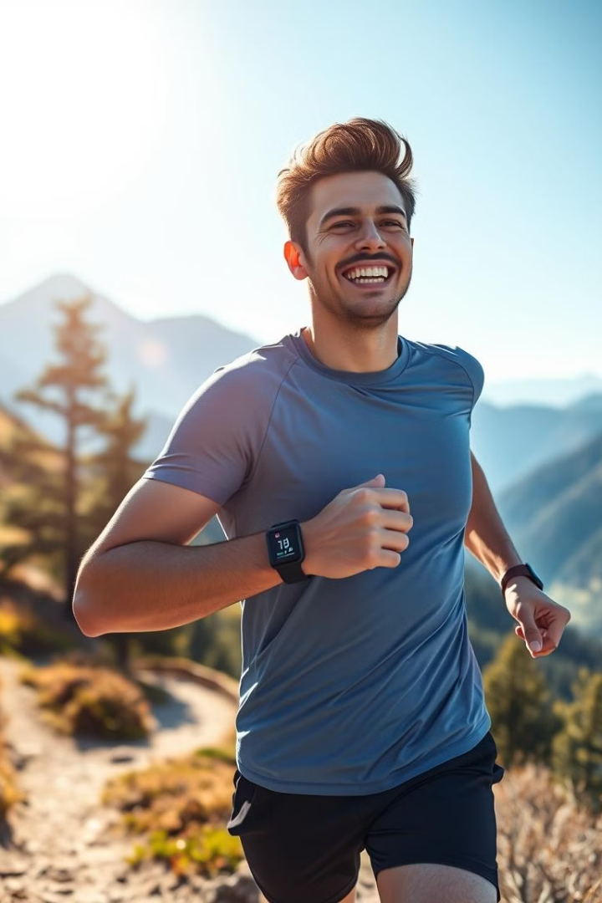
HealthPartner

Slide 2

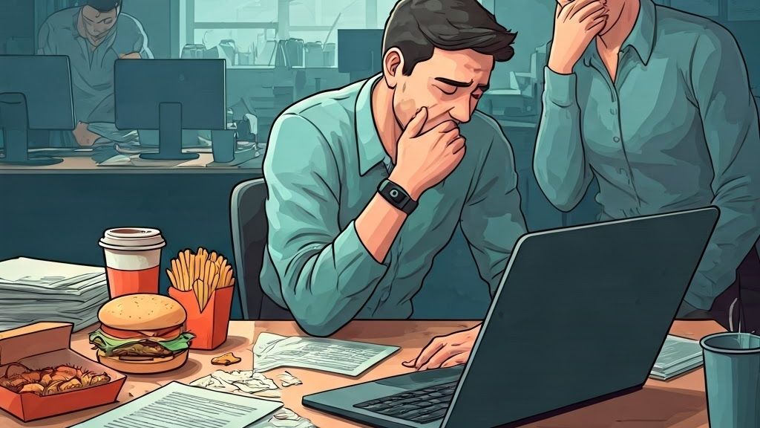
What if ?

Slide 3
We got u

Slide 4
Empowering Users
Motivational Leaderboards
Fitness Tracking
Dietary Insights
Wellness Tools
Monitor your daily activity and progress
Track meals, analyze nutrition, and make informed decisions
Manage stress, sleep, and other essential aspects of well-being
Compete with friends and push yourself to achieve goals

Slide 5
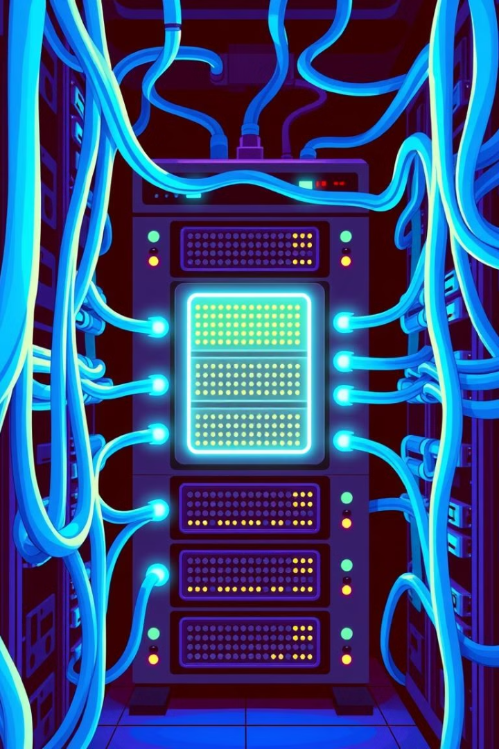
Orchestrating Services: Eureka Server and Load Balancing
1
Centralized Service Registry
2
Dynamic Discovery
Microservices register themselves with Eureka, making them discoverable by others
Eureka acts as a central hub for all microservices
3
Load Balancing
Eureka distributes incoming requests across available microservice instances

Slide 6



Connecting the Front-end: API Gateway
Unified Interface
The API gateway provides a single entry point for front-end requests
Request Routing
The gateway routes requests to the appropriate microservices
Security and Authentication
Enforces security policies and authenticates user requests

Slide 7
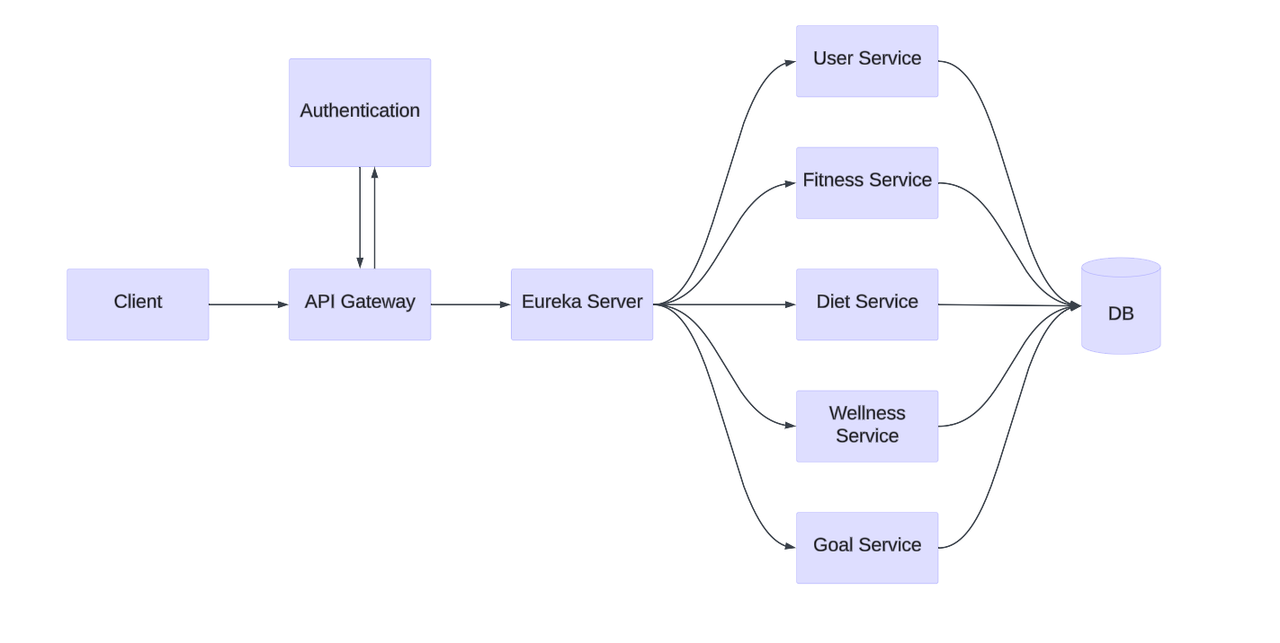
Architecture

Slide 8


Technology Stack Used
Angular
Powerful front-end framework for building dynamic, scalable, and maintainable web
applications with seamless two-way data binding and a rich ecosystem."
Spring Boot
Robust backend framework for building scalable, production-ready Java applications
with minimal configuration and powerful microservices support."
Postgres
A robust database solution for handling the demands of a growing user base

Slide 9
Building Blocks of HealthPartner: Microservices
User Service
Diet Service
Fitness Service
Handles user accounts, dashboards, and leaderboards
Manages dietary tracking and nutrition analysis
Tracks fitness activity and provides performance insights
Wellness Service
Goal Service
Provides tools for stress management, sleep tracking, and more
Allows users to set and track personalized goals

Slide 10
Powerful Partnerships: External APIs
1
2
Edamam
Ninja API
Provides comprehensive nutrition information for food items
Calculates calories burned based on fitness activities

Slide 11


. . .
Future..?

Slide 12
Future
Real time notification
Real time notifications for the users to use the application more efficiently and effectively.
Smart Watch and other wearable Integration
Simplifies the logging activity and makes sure accuracy in fitness data.

Slide 13
Thank You…

